Slide 1
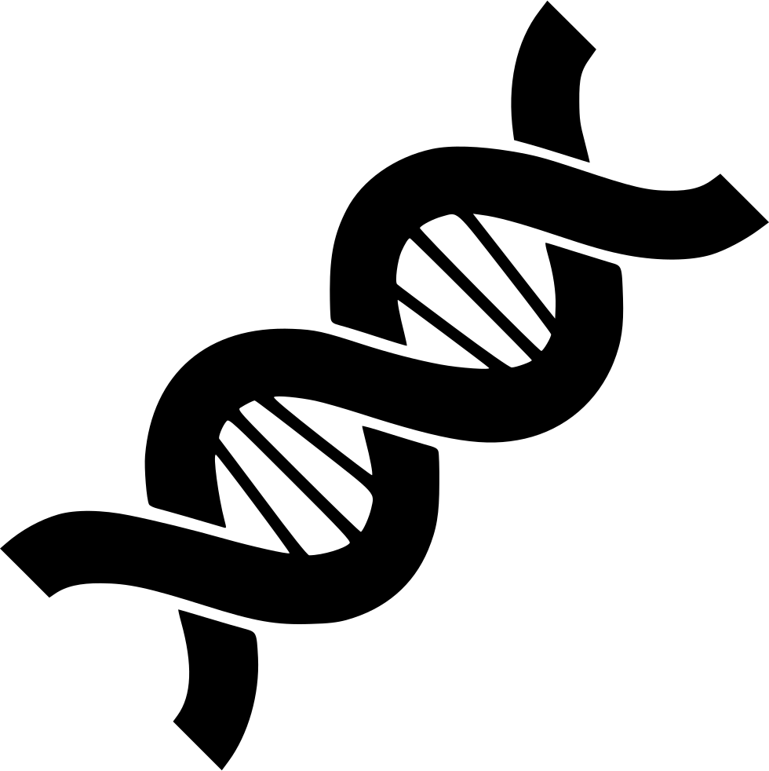
Genetics
Chapter 6.1

Slide 2
6.1 Chromosomes and Meiosis
After this section you will be able to……
Compare germ cells and somatic cells
Explain the purpose of meiosis
Identify chromosomes and their importance

Slide 3

TEKS
6G - recognize the significance of meiosis to sexual reproduction

Slide 4
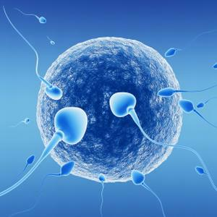
Germ Cells vs Somatic Cells
Germ Cells | Somatic Cells
Also known as sex cells (gametes) | Also known as body cells
Cells in your reproductive organs (testes and ovaries) | All other cells in your body
Will be passed onto offspring | Will not be passed onto offspring
Divide in a process called meiosis | Divide in a process called mitosis
Haploid | Diploid

Slide 5
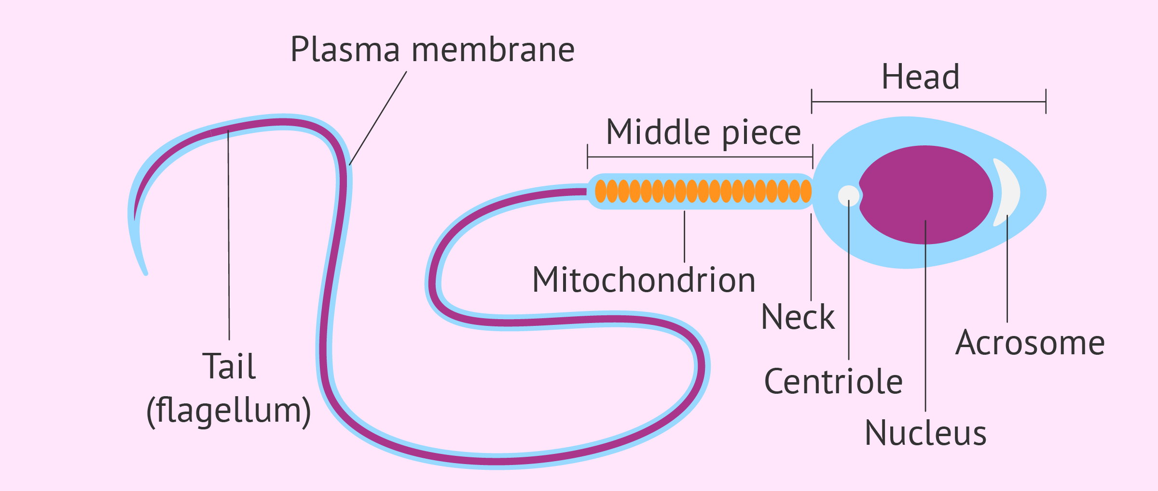
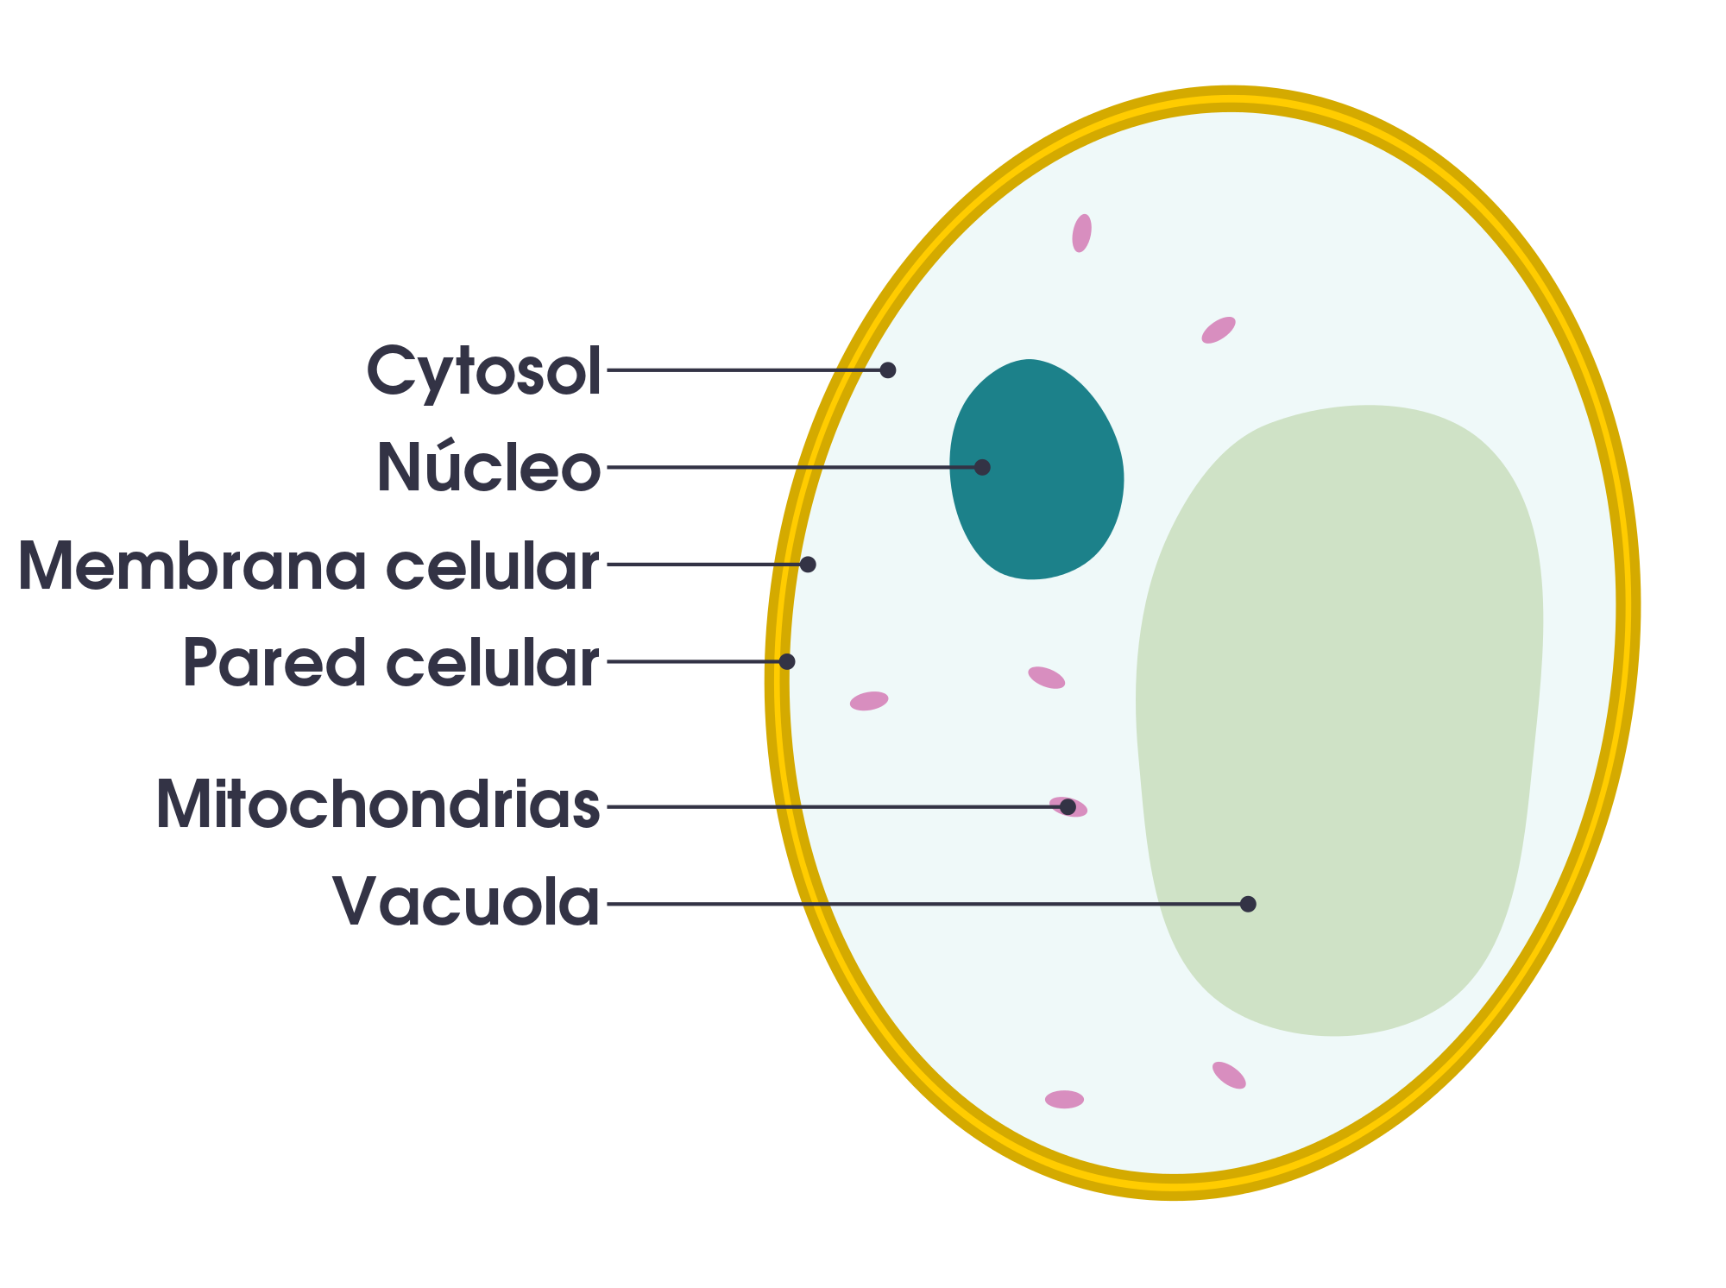
Germ Cells
Germ cells are the cells in your reproductive organs—the ovaries or testes—that develop into eggs or sperm
Gametes are developed germ cells (eggs and sperm)
The DNA from your gametes will be passed onto offspring

Slide 6
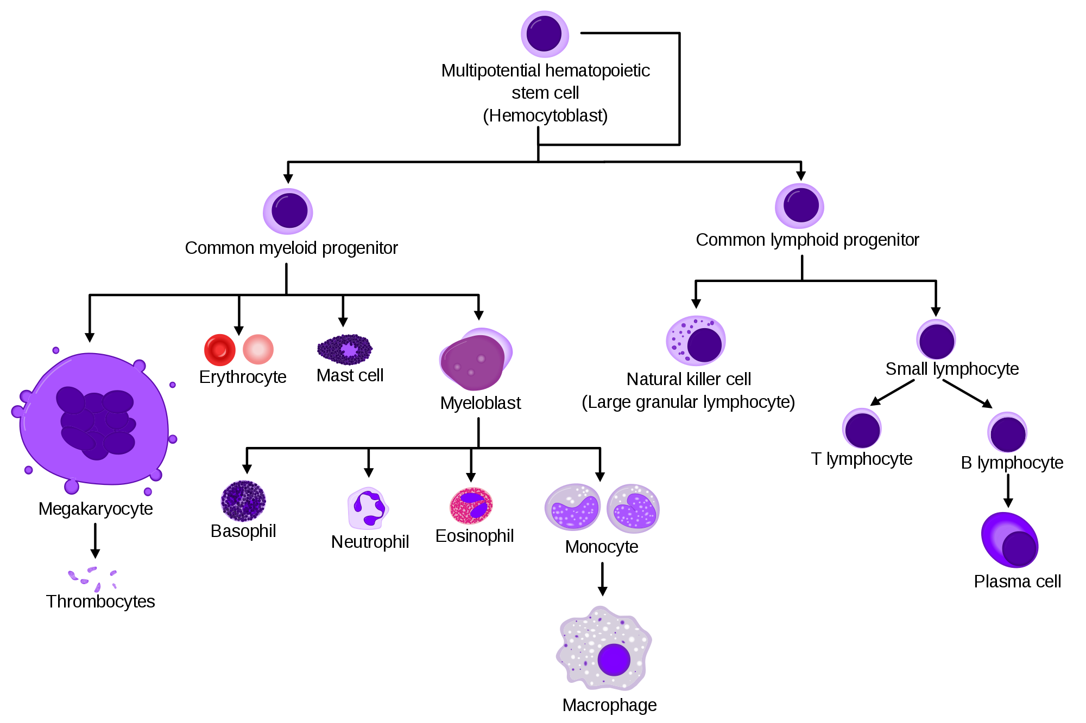
Somatic Cells
Somatic cells (soh-MAT-ihk), or body cells, are all the other cells in your body.
Somatic cells make up most of your tissues and organs
The DNA from your somatic cells will not be passed onto offspring

Slide 7
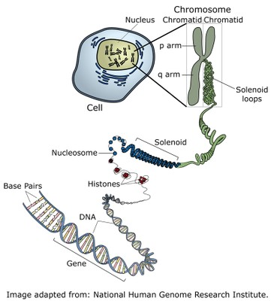
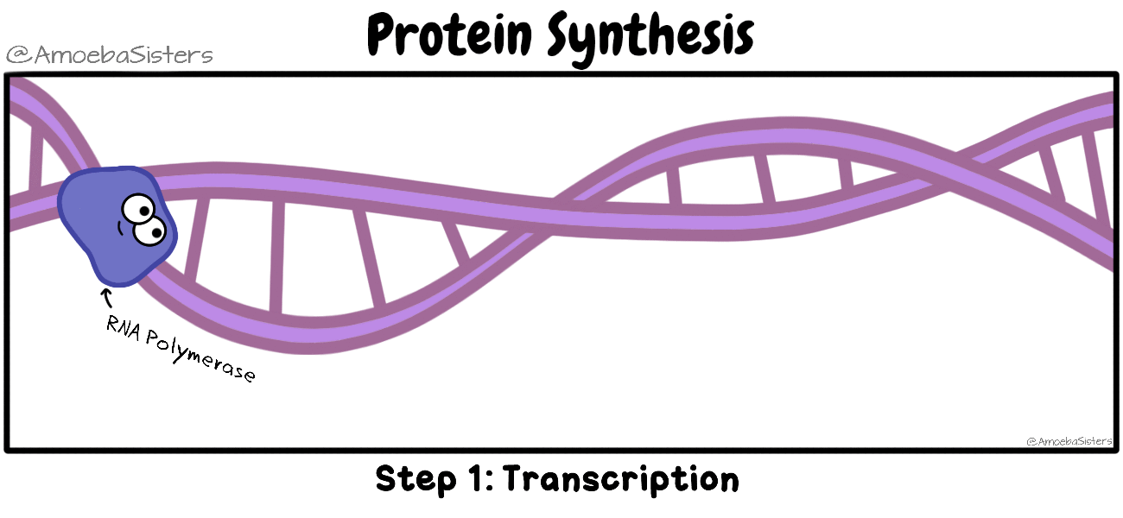
DNA Hierarchy & Protein Synthesis

Slide 8
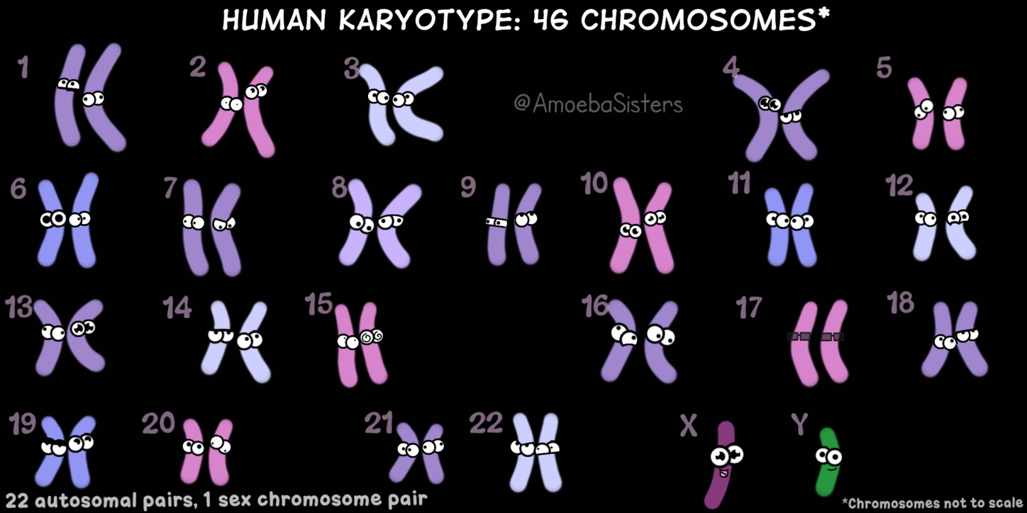

Chromosomes
Humans have 23 pairs of chromosomes.
23 chromosomes come from your mother (egg cell) and 23 come from your father (sperm cell) - 46 total

Slide 9
Chromosomes
Sex chromosomes make up one pair of your 23 sets
XX is female and XY is male
Autosomes are all other pairs. They contain genes all of the rest of an organism’s life functions
Homologous chromosomes are paired together; they contain the same genes from each parent and are the same size

Slide 10
Chromosomes
Is this karyotype a male or female?

Slide 11
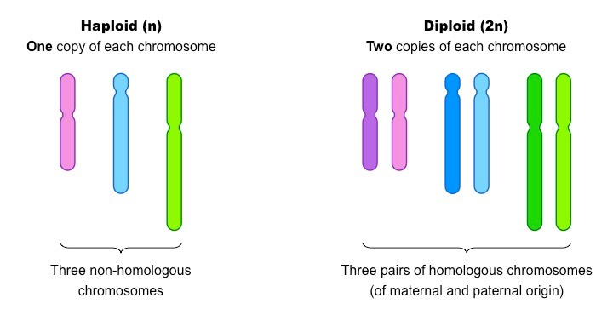
Diploid vs Haploid
Diploid cells contain all chromosomes in an organism. In a human, a diploid cell contains 46 chromosomes (2n)
Haploid cells contain half of the total chromosomes in an organism. In a human, a haploid cell contains 23 chromosomes (n)
All somatic cells are diploid cells
Sperm and egg cells (gametes) are considered haploid, since they each contain only one set of chromosomes

Slide 12
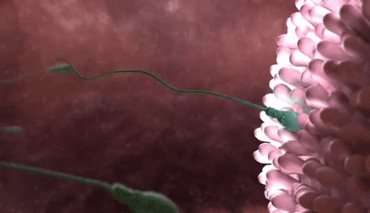
Sexual Reproduction
Sexual Reproduction involves two gametes (egg and sperm) joining together. This process is known as fertilization
When the nucleus of the sperm combines with the nucleus of the egg they form one nucleus, now containing 2n chromosomes. In humans this number is 46

Slide 13
Meiosis
Meiosis is the process in which gametes are formed from germ cells. The diploid cell is divided into a haploid cell.
Be careful not to confuse meiosis with mitosis!!!
Meiosis produces genetically unique cells. This is why we don’t look exactly like our brothers and sisters, although we may have some similarities.
Meiosis only takes place at certain times during an organism's life cycle.

Slide 14
